Slide 1
Outline
n Importance of Project Schedules
n Six Main Processes
1. Planning Schedule Management
2. Defining Activities
3. Sequencing Activities
4. Estimating Activity Durations
5. Developing the Schedule
6. Controlling the Schedule
n Using Software to Assist in Project Schedule Management
2

Slide 2





Importance of Project Schedules (1 of 4)
n Delivering or completing projects on time is one of project managers’ biggest challenges and the main cause of conflict
Time is easily measured and remembered
Time has the least amount of flexibility and passes no matter what happens on a project
n Individual work styles and cultural differences may also cause schedule conflicts
Some people prefer detailed schedules and emphasize task completion. Others prefer to keep things open and flexible.
Different cultures and even entire countries have different attitudes about schedules. Countries may have different holidays => not much work will be done at certain times of the year.
Cultures may also have different perceptions of work ethic. Some may value hard work and strict schedules, while others may value the ability to remain relaxed and flexible.
3

Slide 3
Importance of Project Schedules (2 of 4)
n With all the possibilities for schedule conflicts, it is important for project managers to use good project schedule management
n Project schedule management involves the processes required to ensure timely completion of a project
n Six main processes
1. Planning schedule management: determine the policies, procedures, and
documentation that will be used for planning, executing, and controlling the project schedule.
2. Defining activities: identify the specific activities that the project team and stakeholders must perform to produce the project deliverables.
3. Sequencing activities: identify and document the relationships between project activities.
4

Slide 4

Importance of Project Schedules (3 of 4)
4. Estimating activity durations: estimate the number of work periods that are needed to complete individual activities.
5. Developing the schedule: analyze activity sequences, resource requirements, and activity duration estimates to create the project schedule.
6. Controlling the schedule: control and manage changes to the project schedule.
n We can improve project schedule management by performing these processes and by using some basic PM tools and techniques
Gantt charts
Network diagrams
Critical path analysis
Critical chain scheduling
etc.
5

Slide 5
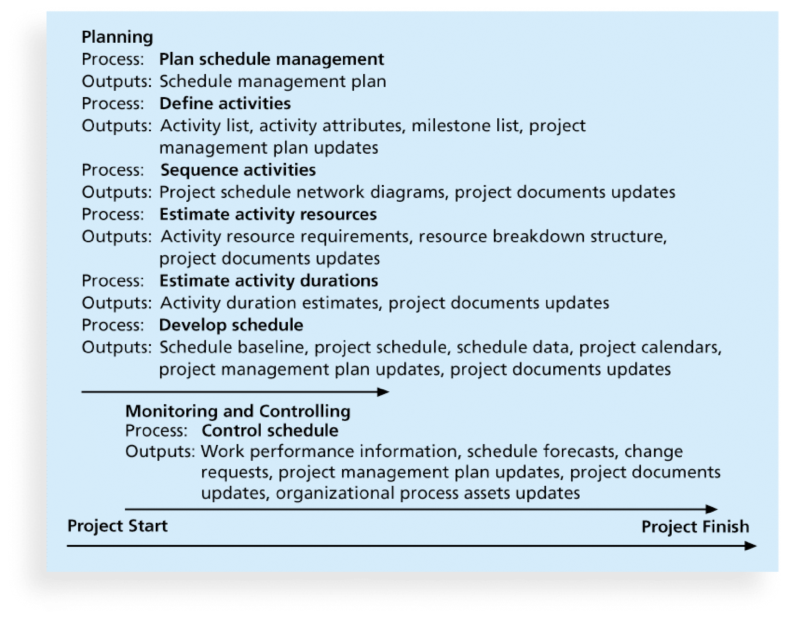
Importance of Project Schedules (4 of 4)
=> Project Resource Management
6

Slide 6

1. Planning Schedule Management (1 of 2)
n The 1st step in schedule management is to plan how the schedule will be managed throughout the life cycle of the project
n Project schedules grow out of the basic documents (e.g., project charter, the PM plan, organizational process assets) that initiate a project
After reviewing these documents, the project team uses expert judgement, analytical techniques, and meetings to develop schedule management plan
n The schedule management plan can be informal and broad, or formal and detailed, based on the needs of the project. In general, it includes the
following information
i. Project schedule model development: Many projects include a schedule model, which contains project activities with estimated durations,
dependencies, and other planning information that can be used to produce a project schedule.
7

Slide 7
1. Planning Schedule Management (2 of 2)
ii. Level of accuracy and units of measure discusses how accurate schedule estimates should be and determines whether time is measured in hours,
days, or another unit.
iii. Control thresholds: Variance thresholds, such as +/- 10%, are established for monitoring schedule performance.
iv. Rules of performance measurement. For example, if team members are
expected to track the percentage of work completed, this section specifies how to determine the percentages.
v. Reporting formats describe the format and frequency of schedule reports required for the project.
vi. Process descriptions describe how the schedule management processes will be performed.
8

Slide 8


2. Defining Activities (1 of 3)
n Defining activities identifies the specific actions that will produce the detailed project deliverables to determine resource and schedule
estimates
Outputs include an activity list, activity attributes, a milestone list, change requests, and PM plan updates
n An activity list is a tabulation of activities to be included on a project schedule that include 1) activity name, 2) activity identifier or number, and 3) a brief description of the activity
An activity or task is an element of work normally found on WBS that has an expected duration, a cost, and resource requirements
n Activity attributes provide schedule-related information about each
activity, such as predecessors, successors, logical relationships, resource requirements, constraints, imposed dates, and assumptions related to the activity
9

Slide 9



2. Defining Activities (2 of 3)
n The activity list and activity attributes should agree with the WBS and WBS dictionary
n A milestone is a significant event that normally has no duration
It often takes several activities and a lot of work to complete a milestone, which itself is a marker to help in identifying necessary activities.
Useful tools for setting schedule goals and monitoring progress
Examples: obtaining customer sign-off on key documents or completion of specific products
n Not every deliverable or output created for a project should be marked as a milestone. Milestones are the most important and visible events.
n Activity information is a required input to the rest ofthe project schedule management processes
10

Slide 10


2. Defining Activities (3 of 3)
n Goal of defining activities: ensure that the project team completely
understands all the work it must do as part of the project scope so that they can start scheduling the work
The project team must understand what each WBS item means before team members can make schedule-related decisions
The WBS is often analyzed further (& updated) as the project team members continue to define the activities required for performing the work
n The project team should review the activity list and activity attributes with project stakeholders before moving on to the next step in project schedule management
Otherwise, it could produce an unrealistic schedule and deliver unacceptable results
Clearly defining the work is crucial to all projects. If misunderstandings about activities exist, requested changes may be required.
11

Slide 11


3. Sequencing Activities (1 of 7)
n Sequencing process involves evaluating the reasons for dependencies and the different types of dependencies.
A dependency or relationship is the sequencing of project activities or tasks
Crucial for developing and managing a project schedule
n Four reasons for dependencies
i. Mandatory dependencies are inherent in the nature of the work being performed on a project (hard logic). Ex: write code => test code
ii. Discretionary dependencies are defined by the project team (soft logic).
Ex: officially sign off the project charter => start project planning
iii. External dependencies involve relationships between project and non-
project activities. Ex: delivery of a new hardware => install software
iv. Internal dependencies involve relationships between project activities that are generally inside the project team’s control. Ex: perform unit testing => perform system testing
12

Slide 12

3. Sequencing Activities (2 of 7)
n Network diagrams are the preferred technique for showing activity sequencing
n A network diagram is a schematic display of the logical relationships among project activities and their sequencing
Two main formats: 1) arrow diagramming method (ADM), and 2) precedence diagramming method (PDM)
n Arrow diagramming method (ADM) or Activity-on-arrow (AOA) approach
A network diagramming technique in which activities are represented by arrows and connected at points called nodes to illustrate the sequence of activities
A node is the starting or ending point of an activity. The first node signifies the start of a project, and the last node represents the end.
13

Slide 13


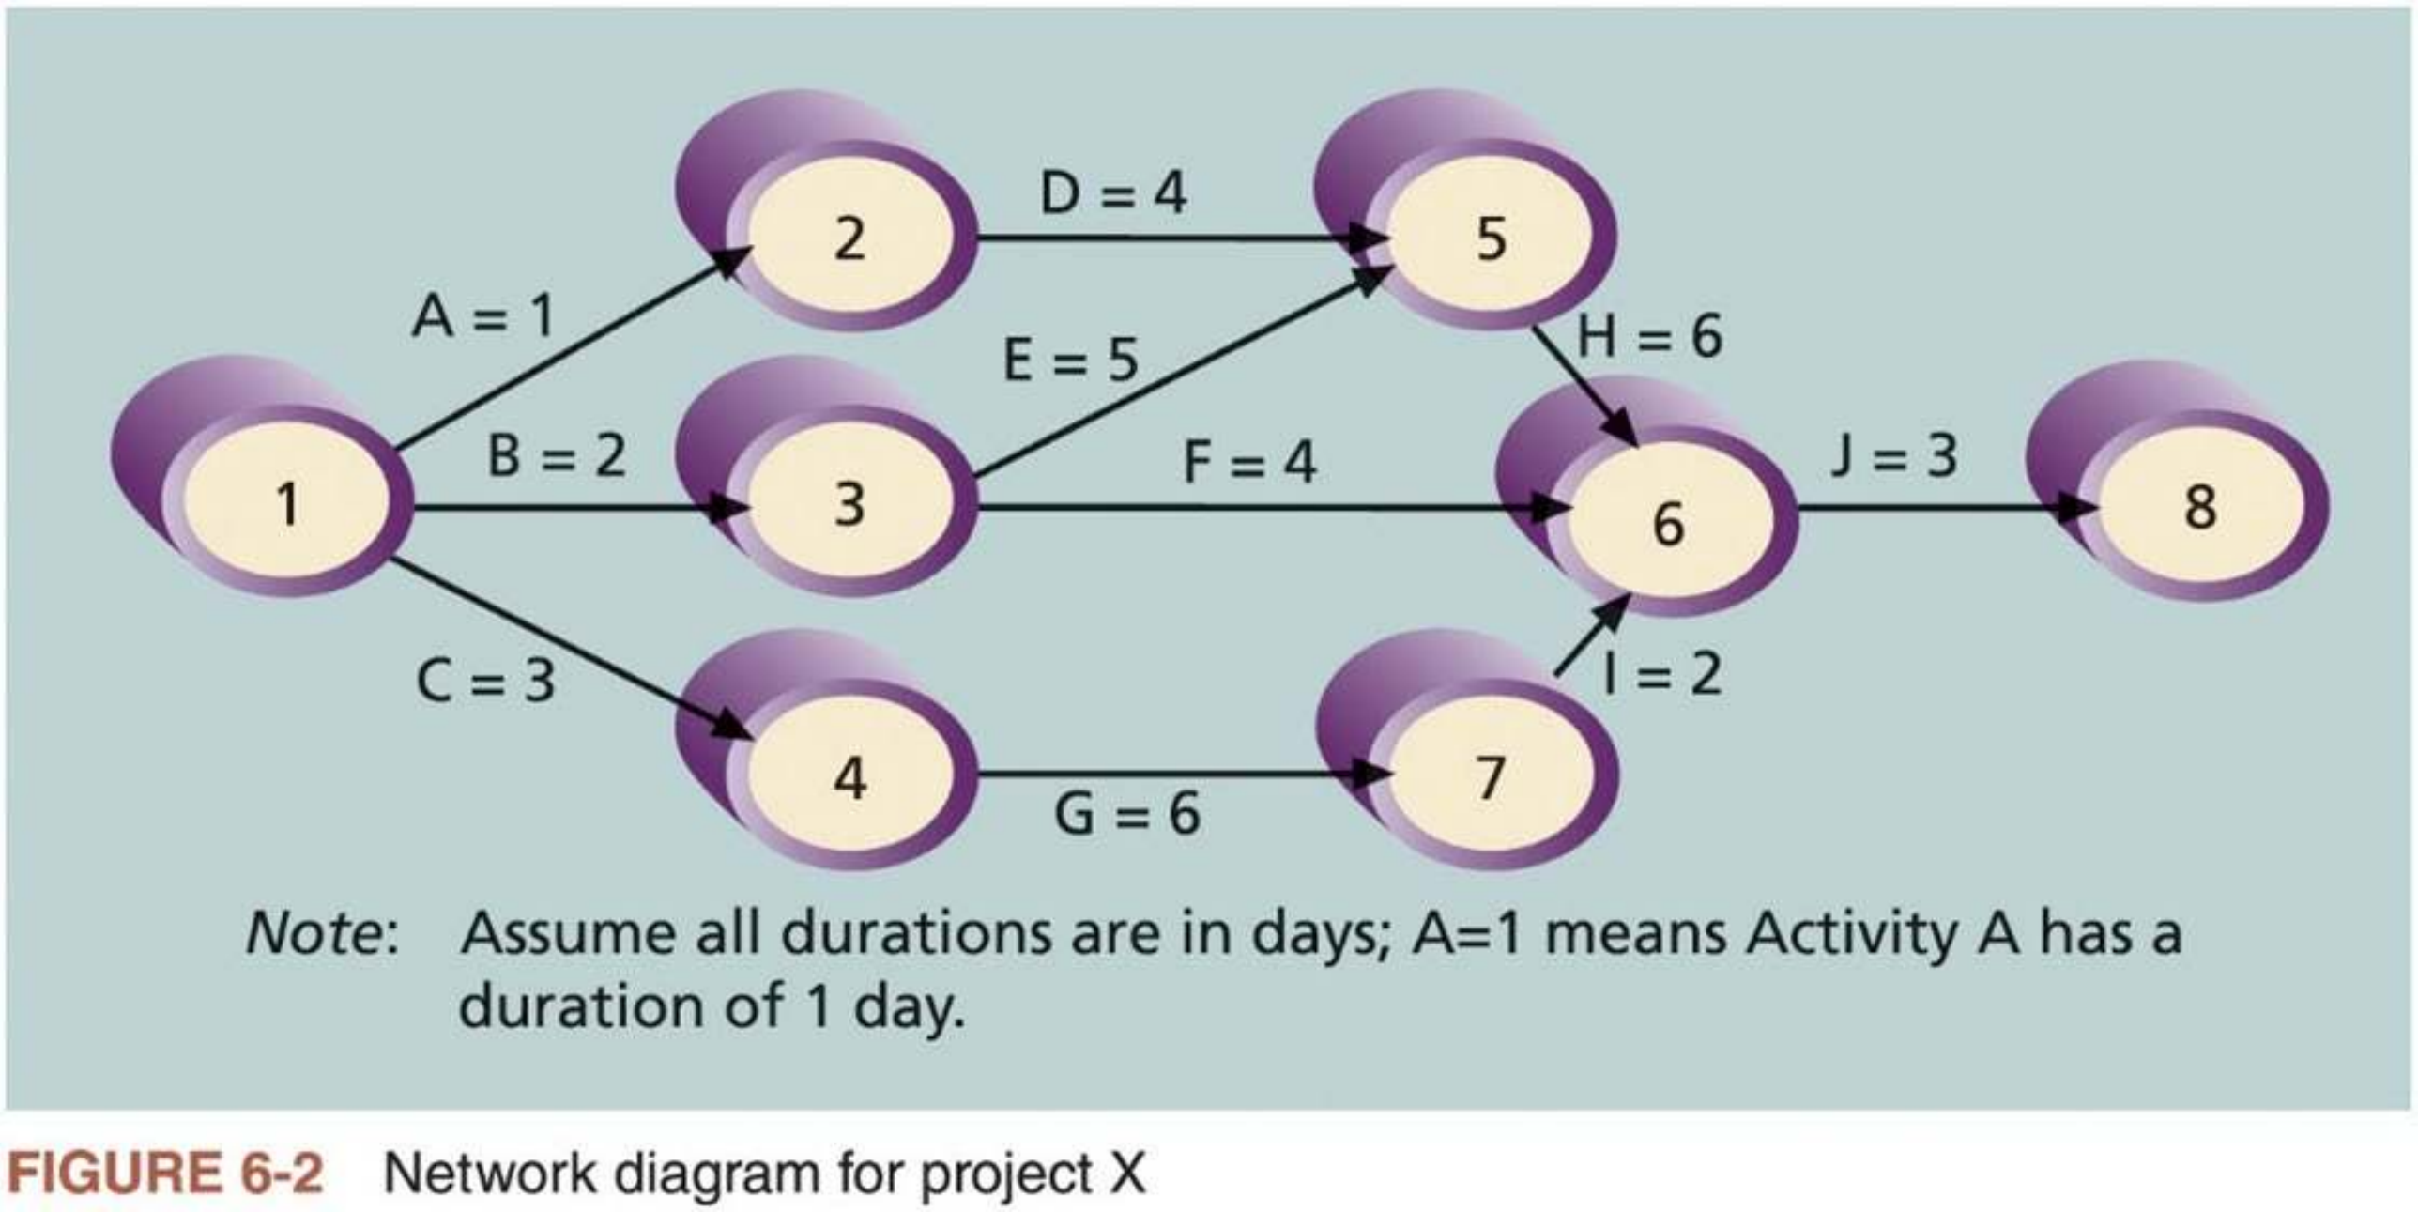
3. Sequencing Activities (3 of 7)
n Figure 6-2 shows an ADM network diagram
The letters A through J represent activities with dependencies that are required to complete the project
The arrows represent the activity sequencing or relationships between tasks
14

Slide 14


3. Sequencing Activities (4 of 7)
n Steps for creating an ADM diagram (assuming you already have a list of project activities and their start and finish nodes)
1. Find all activities that start at Node 1. Draw their finish nodes and draw
arrows between Node 1 and each of the finish nodes. Put the activity letter or name on the associated arrow. If you have a duration estimate, write it next to the activity letter or name, as shown in Figure 6-2.
2. Continue drawing the network diagram, working from left to right. Look for bursts and merges:
Bursts occur when two or more activities start from a single node.
A merge occurs when two or more nodes end with a single node.
3. Continue drawing the ADM network diagram until all activities are included.
4. As a rule of thumb, 1) all arrowheads should face toward the right, and 2) no arrows should cross on an ADM network diagram. You may need to redraw the diagram to make it look presentable.
15

Slide 15
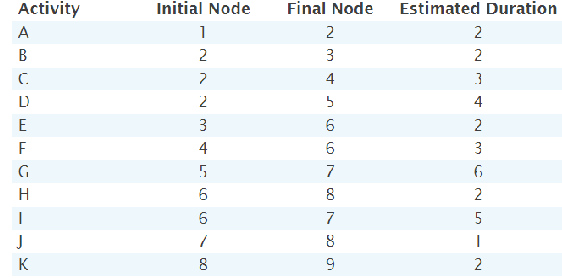
Exercise 1: ADM Network Diagram
n Draw an ADM network diagram representing the project below. Put the node numbers in circles and draw arrows from node to node, labeling
each arrow with the activity letter and estimated time.
16

Slide 16
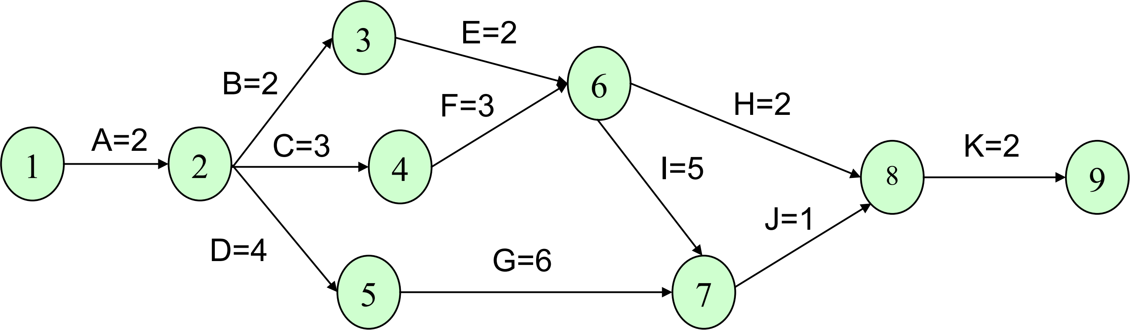
Exercise 1: Sample Solution
17

Slide 17
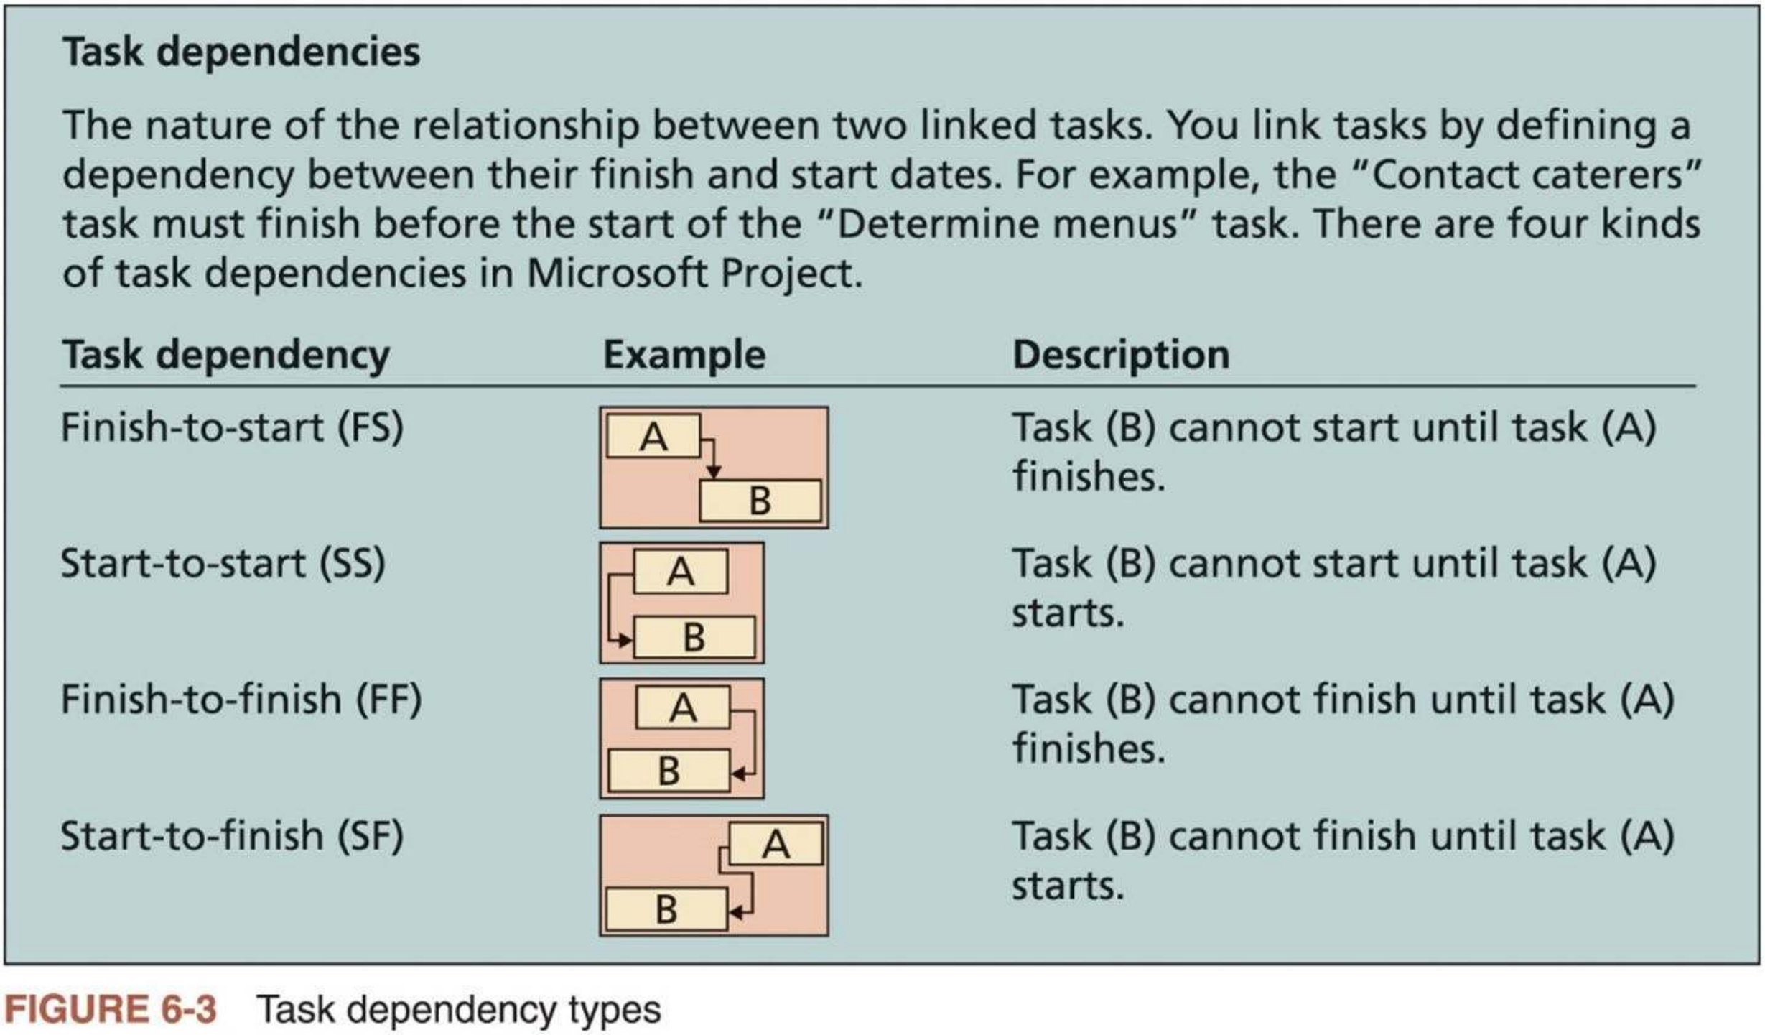
3. Sequencing Activities (5 of 7)
n Precedence diagramming method (PDM) is a network diagramming technique in which boxes (or circles) represent activities
n Four types of dependencies or relationships between activities
18

Slide 18


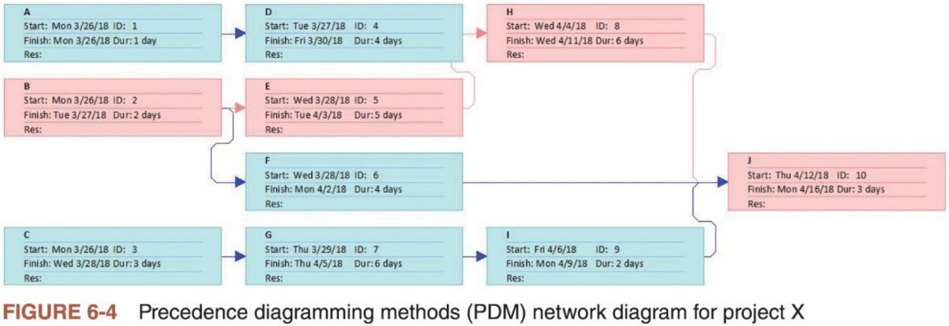
3. Sequencing Activities (6 of 7)
n Figure 6-4 shows the same project X in Figure 6-2 using PDM by Microsoft Project
Activities are placed inside boxes, which represent the nodes
Arrows show the relationships between activities
Boxes for tasks on the critical path are automatically in red in Microsoft Project
19

Slide 19
Exercise 2: PDM Network Diagram
n Draw a PDM network diagram representing the same project in Exercise
1. Put the activities in boxes, including the activity letter and estimated time inside each box, and draw arrows from box to box.
B=2
C=3
D=4
E=6
F=3
G=6
H=2
I=5
J=1
K=2
A=2
20

Slide 20



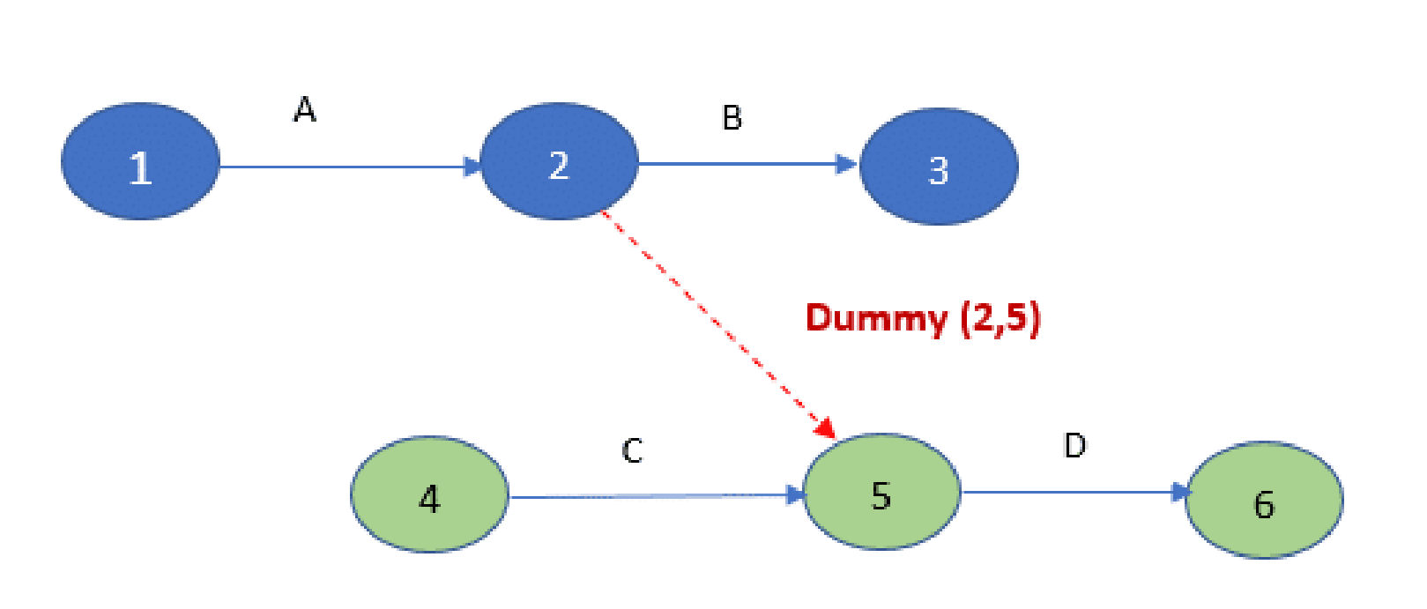
3. Sequencing Activities (7 of 7)
n Advantages of PDM over ADM network diagrams
PDM can show different dependencies among tasks, whereas ADM network diagrams use only finish-to-start (FS) dependencies
PDM avoids the need to use dummy activities. Dummy activities have no
duration and no resource, but they are occasionally needed on ADM to show logical relationships between activities. These activities are represented with dashed arrow lines and have zeros for their durations.
Most project management software uses PDM
ADM
A
C
B
D
PDM
21

Slide 21


4. Estimating Activity Durations (1 of 2)
n Activity duration includes the actual amount of time worked on an activity plus elapsed time
Duration is different from effort, which is the number of workdays or work hours required to complete a task
For example, if someone asked for an estimate of when you plan to finish
reading a particular book, you might give an answer of two months, even if you plan to spend 20 hours reading the book. In this case, two months would be duration, and 20 hours are effort.
n Duration estimates are often provided as a discrete number, as a range, or as a three-point estimate, which includes an optimistic, most likely, and
pessimistic estimate
A three-point estimate is required for performing PERT estimates and for performing Monte Carlo simulations
Other duration estimating techniques include analogous and parametric
estimating and reserve analysis (to be discussed in Lecture 5, Project Cost Management) and expert judgment
22

Slide 22


4. Estimating Activity Durations (2 of 2)
n Project team members must document their assumptions when creating duration estimates
The people who will do the work should have a lot ofsay in duration estimates
It is helpful to review similar projects and seek the advice of experts in estimating activity durations
n Project team members must also update the estimates as the project progresses to reflect changes
n A key consideration in estimating activity duration is the availability of resources, especially human resources
Estimating activity resources will be discussed in Lecture 7, Project Resource Management
n Outputs of estimating activity durations: the estimates, the basis of estimates, and project documents updates
23

Slide 23
Advice for Young Professionals
n Some people find estimating to be challenging, especially for their own work. However, it is very important to develop this skill.
n Practice estimating how long it takes you to do different activities and then take actual measurements
i. Defining the activity in detail will help you make better estimates about each part of the activity
ii. Don’t be afraid to ask for help in making estimations. People with experience can help us be more realistic with estimates.
iii. Start with estimating activities like writing reports, arranging meetings, or creating a presentation.
n If you realize that an activity estimate might NOT be a good one, let your
team know ASAP so that adjustments can be made early in the project.
24

